Slide 1
Maintaining Goodwill in Bad-News Messages
Chapter Eight

Slide 2
Bad News Messages
At work, almost everyday you have to deal with bad news
A message that receives unfavorable responses from the reader is called a bad-news message
A lot of communicators fail to successfully organize bad-news messages
To succeed, follow effective skills, plans and strategies

Slide 3

Examples of Bad News Messages
Request refusals
Adjustment refusals (Denying a customer’s claim)
Credit Refusal
Order refusals
Negative Announcements

Slide 4
Skills for Negative-News Messages
Emotional Intelligence (EI) is the ability to identify and manage your own emotions and the emotions of others.

Slide 5
Lack of EI
We received your application for an HR generalist position at Surf Protect. Unfortunately, we cannot offer you this position. Furthermore, at this time, we don’t have any match between your skill set and our needs. As such, you are not required in the near future. You can try other organizations.
Sincerely,
Mark A. Herschberg

Slide 6
Your Turn
Do you possess Emotional Intelligence?

Slide 7
Left/Right Brained?
Left-brained | Right-brained
Logical | Emotional
Analytical | Thoughtful
Objective | Subjective
Critical thinking | Creative
Numbers | Intuition

Slide 8


Types of Organizational Plans
There are two types of organizational plans
Direct Plan
Indirect Plan

Slide 9
How to Decide on the Plan?
A good beginning is to assess readers’ probable reaction
Positive or neutral reaction should invite you to adopt the direct plan
Negative reaction should invite you to implement the indirect plan

Slide 10
Direct vs. Indirect Plan
Direct Plan | Indirect Plan
Applies to positive-news messages | Applies to negative-news messages
Communicates directly | Communicates indirectly
Get to the point/ objective right away | Involve buffering
Emphasizes on establishing rapport whilst presenting the positive news | Emphasizes on presenting the negative news positively

Slide 11
The Indirect Pattern
Buffer
Present the
Bad News
Positively
Setting Up
the Negative
News
Offering an
Alternative
Solution
Ending on a
Positive
Note
Apologizing

Slide 12
The Indirect Pattern
Buffer
- An opening that identifies the subject of the message but doesn’t indicate that negative news is coming
- The buffer can be neutral or positive
- Avoid tipping off the bad news too early
- Avoid starting too positive so as to build false hopes
Setting Up the Bad News
- Give the reason
- Communicate the reason in such a way that the reader accepts the reason as positively as possible
- Explain the fairness of the action
- Provide a smooth transition from the opening to the explanation

Slide 13
The Indirect Pattern
Present the bad news positively
Present the bad news now
Place negative news in buried position
Avoid unnecessary use of negative words
State the bad news once; avoid restating or returning to it
Use first and third person. Avoid “you view” point
Don’t: “Since you have broken the seal, state law prohibits us from returning the product to stock”.
Do: “State law prohibits us from returning to stock all products with broken seals”

Slide 14
The Indirect Pattern
Offering an Alternative Solution
- Try to emphasize on the alternative solution
- It is always a good strategy to focus on what you can do for the reader
Ending on a Positive Note
- Shift the thoughts of the readers to happier things
- Your comments should not recall the negative message
- End with a positive, forward-looking idea
Apologize
- Sometimes an apology can make a situation better, but other times it can make a bad situation worse
- If you apologize do it early in the message

Slide 15

Compose a Draft
Begin with a neutral or pleasant statement.
  Begin with a buffer.
  Choose words carefully.
  Avoid misleading the receiver.
Explain the reason(s) for the referral.
  Explain why you cannot do what the receiver wants.
  Use the passive voice to avoid sounding accusatory.
State or imply the refusal.
  State the refusal concisely.
  State what can be done rather than what cannot be done.
  Avoid negative words.
Offer an alternative solution or action.
  Offer a constructive suggestion, substitute, counterproposal, or alternate course of action.
  Explain how the receiver may benefit.
End with a positive, friendly statement.
  Conclude with a positive statement.
  Avoid trite expressions.
  Close with action required by the receiver.

Slide 16
Refusal of a Request
Initial considerations:
The news is bad.
The reader wants something; you must refuse.
Your goals are:
  to say no, and
  to maintain goodwill.
The first goal is easy; the second requires tact.
You must present reasons that will convince.

Slide 17
Brief Review of a Procedure for the Refusal of a Request
The message plan:
Opening
Buffer- identifies the subject but doesn’t indicate that negative news is coming
Present reasons using positive language
Refuse clearly and positively, embedding where possible to de-emphasize the negative.
Include a counterproposal or compromise when appropriate.
End with an adapted goodwill comment.
Body
Closing

Slide 18
Example: Refusal of a Request
Mark Stephen runs a big company that is concerned with its Corporate Social Responsibility (CSR). The company involves donating money for the betterment of the children every year.
Terry Driscoll is currently looking after a charity organization which is in need of urgent money for supporting some school going children in the city. As such, Mr. Terry has requested Mr. Mark to donate some money for his organization.
However, unfortunately, Mark is not in a position to help Terry as the budgeted contributions for this year have already been made. All Mark can do is place Terry’s organization for consideration next year.
Now, Mark needs to refuse the request via a letter.

Slide 19
Example: Refusal of a Request (cont.)
Subject: Your request for a donation
Mr. Terry Driscoll:
We regret to inform you that we cannot grant your request for a donation to the association’s scholarship fund.
So many requests for contributions are made of us that we have found it necessary to budget a definite amount each year for this purpose. Unfortunately, our budget funds for this year have been exhausted, so we simply cannot consider additional requests. We won’t be able to consider your request until next year.
We deeply regret our inability to help you and trust you understand our position.
Regards,
Mark Stephen

Slide 20
Example: Refusal of a Request (cont.) (A Lot Better!)
Subject: Scholarship Fund Request
Mr. Terry Driscoll:
Your effort to build the scholarship fund for the association’s needy children are commendable.
We assist worthy causes whenever we can. That is why every year January we budget in the upcoming year the maximum amount we believe we are able to contribute to such causes. Then we distribute that amount among the various deserving groups as far as it will go. Since our budgeted contributions for this year have already been made, we are placing your organization for consideration next year.
We wish your success in all your efforts to improve the lives of the children in our city.
Regards,
Mark Stephen

Slide 21
Initial Considerations in Writing
Credit Refusals
Refusals of credit are very negative, tending to reflect on one’s personal qualities.
They should be handled tactfully
Begin by developing an explanation.
  If finances are weak--can be fairly direct.
  If morals are weak--should be tactful.

Slide 22
Brief Review of Procedure for
Credit Refusals
The message plan:
Opening
Begin with words that
  are neutral, and
  tie in with document being answered.
  set up the strategy (explanation).
Present the explanation and/or justification.
As a logical follow-up--refuse tactfully.
  If to a bad moral risk, may be by implication.
  If to one with weak finances,
    should refuse positively, and
    look hopefully to the future.
Close with goodwill words that fit the one case and are friendly and forward-looking.
Body
Closing

Slide 23
Credit Refusal
Imagine, you are a customer relationship manager at Argos. One of your customers named John Lamb has made a formal application on March 29 to buy an iPhone 6+ on credit. You have done the research on his credit history and found that he has an unusually heavy burden of invoices to pay within the next few months. As such, you can only allow him to buy the product by cash. However, just as soon as his situation is improved, you can accept the original application.
Write a letter to Mr. John to communicate the bad news

Slide 24
Tact in a Credit Refusal
Opening
Dear Mr. John:
Your March 29 application for credit was genuinely appreciated. We are especially grateful for your pleasant frankness in presenting your request for credit.
Click to view full letter at once.

Slide 25
Tact in a Credit Refusal
Body
In checking over them, we find that you have an unusually heavy burden of invoices to pay within the next few months. As we see it, burdening you with more bills to pay at this time simply would not make good business sense. Thus, we can sell to you only for cash now. By buying for cash and taking advantage of the cash discount, you would be taking a sound step toward improving the financial health of your business. Just as soon as your situation is improved, we shall open your account.

Slide 26
Tact in a Credit Refusal
Closing
We look forward to receiving your order soon. It should mark the beginning of our relationship.

Slide 27
Initial Considerations in Denying a Customer’s Claim
The decision has been made to refuse an unjustified claim.
The news is bad.
The goal is to present the bad news in a positive way.
Thus, you must think through the situation to develop a strategy to explain or justify the decision.

Slide 28
Brief Review of Procedure for Denying a Customer’s Claim
The message plan:
Opening
Begin with words that
  are off subject,
  are neutral, and
  set up the message.
Present the strategy that will explain or justify.
Make it factual and positive.
Lead systematically to the refusal.
Then refuse--clearly and positively.
End with off-subject, friendly words.
Body
Closing

Slide 29
Denying a Customer’s Claim
Imagine, you are a customer relationship manager at a BHG.com. Your company sells panels for office buildings. A customer named Shane Johnson approached you via a letter on May 11, 2015 in order to return his panels. After reviewing his order, you have found that the architect of Mr. Shane specified a most unusual and distinctive finish. His specifications were in careful detail, and you followed them to the letter. Although the finished paneling is genuinely beautiful, it is unique and could not go into your regular stock. For this reason, you feel that any adjustment in this case must be between Mr. Shane and his architect.
Your task: Write a letter to Mr. Shane Johnson in order to communicate the bad news

Slide 30
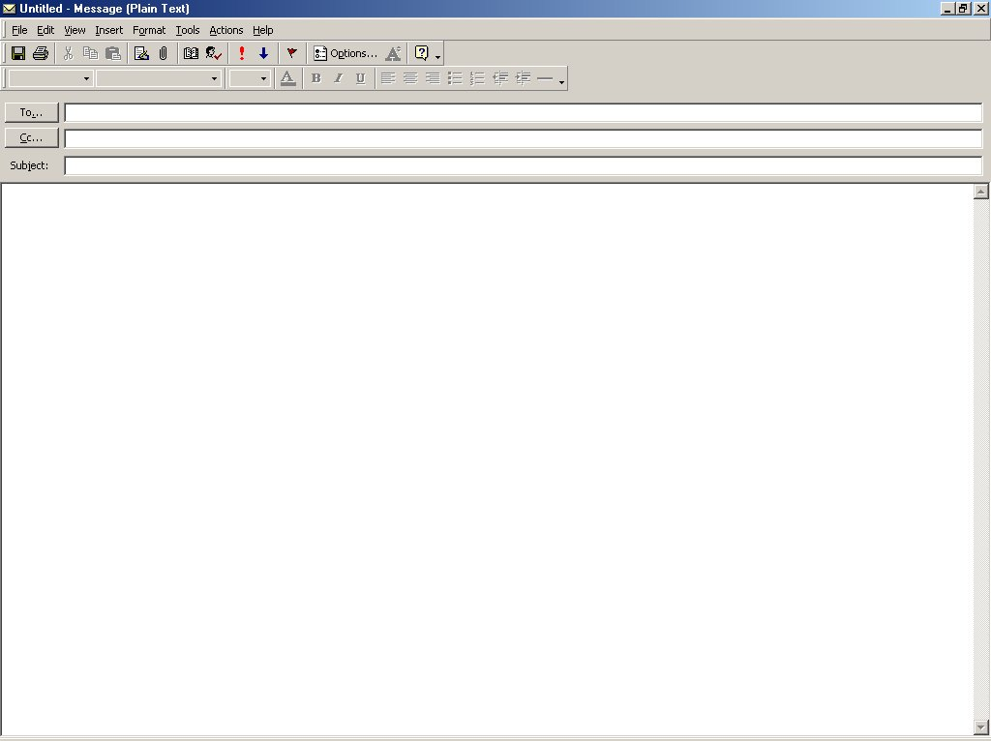
rjluce@uniquesupplies.com
Special paneling concern
Mr. Shane:
Certainly we understand your concern expressed in your May 11 letter about getting just the right material for your new office building. We share this concern with you. And we are determined to do our part about it.
To see whether we have done our part about your special paneling, we reviewed the facts of the case. We find that your architect specified a most unusual and distinctive finish. His specifications were in careful detail, and we followed them to the letter. Although the finished paneling is genuinely beautiful, it is unique and could not go into our regular stock. For this reason, we feel that any adjustment in this case must be between you and your architect. I am confident that you will see the justice in our decision.
We are grateful for the role we have played in constructing your distinctive building.

Slide 31
rjluce@uniquesupplies.com
Special paneling concern
be between you and your architect. I am confident that you will see the justice in our decision.
We are grateful for the role we have played in constructing your distinctive building. We stand ready to meet your future needs to the letter.
Dominic Terrado

Slide 32
_x000f_Other Negative Messages
Other negative messages include order refusal, negative announcement, claims and so forth
Use the indirect plan and same structure to establish those messages
Read the books for more examples

Slide 33
